Slide 1
12. Hash Tables
ECE 309
Dr. James Tuck

Slide 2
Objectives
Describe a set and the functions commonly in its interface.
Describe a hash table, its basic parts, and common operations.
Describe the purpose of the override keyword and use it in a program.
Use an abstract base class to specify the hash table interface and a derived class for its implementation

Slide 3
The Set abstract data type
A Set is a collection of items; items may be stored either ordered or un-ordered with respect to their values
Examples of ordering: alphabetical, least to greatest, etc.
Sets support at least the following operations:
insert: add an item to the set (may or may not allow duplicates)
find: determine if an item is already in the set
remove: remove an item in the set (if duplicates allowed, may remove only one or all matching items)

Slide 4
Set Abstract Base Class
// generic abstract class for a set
template <typename T>
class Set {
public:
virtual bool insert(T) = 0;
virtual bool find(T) const = 0;
virtual void remove(T) = 0;
};

Slide 5
Integer Set Abstract Base Class
// To keep things simple for now, we’ll just assume
// integers
class IntegerSet {
public:
virtual bool insert(int) = 0;
virtual bool find(int) const = 0;
virtual void remove(int) = 0;
};

Slide 6
Example of set operations
Consider a set holding integers (allowing duplicates)
Operation | State of Set | Result
insert(10) | {5, 19} | {5, 19, 10}
insert(10) | {5, 10, 19} | {5, 10, 10, 19}
remove(19) | {5, 10, 19} | {5, 10}
remove(1) | {5, 10} | {5, 10}
find(5) | {5, 10} | True, 5 is in the set

Slide 7
Implement a set using a linked list
Create a derived implementation based on a linked list and evaluate the big-O for each function.

Slide 8
Linked lists aren’t great for sets
A linked list is effective at managing a collection in an order
Examples: Stack, Queue
But, it’s not efficient to find an item in a list
What if we don’t care about order and we just want to find an item efficiently?
Better approach: Hash Table

Slide 9
Hash Table overview
A hash table is a data structure that stores unordered items by mapping (or hashing) each item to a location in an array.
The key advantage is that searching for an item is O(1) on average.

Slide 10
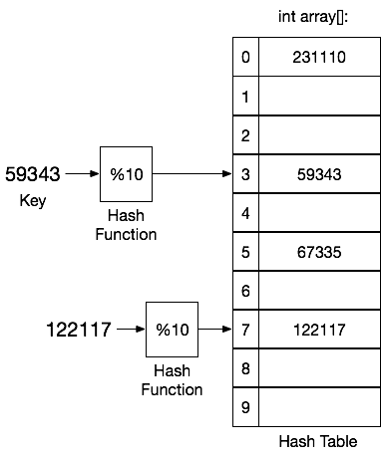
Parts of a hash table
Data is what we want to put in the table;
it can be anything, but it’s often a pointer or reference to avoid copying objects.
The example uses an int as the data
The key is the part of the data used by the Hash function;
The key should be unique for each unique data item
Key and data can be the same (we will assume this, but it’s not required)
The key could be a single field of a larger data object
Hash Function: turns the key into an index in the hash table array.
Hash Table is an array that holds the data.
Each entry in the table is called a bucket
We need to know how much data we expect to hold in advance so that we can make a large enough array.
Hash Table holds {231110, 59343, 67335, 122117}

Slide 11
Why is searching a hash table fast?
We can calculate an index in O(1)
We can lookup an array entry in O(1)
We can compare keys (integral types) for a match in O(1)
Hence, an insertion, find, and removal can be done O(1)

Slide 12
Common operations on a hash table
insert(key,data): add data to the hash table using key
If key and data are the same, only one argument is needed
Optional: whether to allow multiple insertions of the same data or not
search(key): check to see if data with corresponding key is in the hash table
Many options for the return value of search: the data, true/false, an iterator
remove(key): remove all data with corresponding key

Slide 13
Hash table implementation
There are many ways to implement a hash table
We’ll define an abstract base class that defines the basic interface and shared functionality
Then, we’ll implement it two different ways

Slide 14
IntegerSetHT derived class
class IntegerSetHT : public IntegerSet {
protected:
int size;
int hash(int key) { return (key * 997) % size; }
int *table; // pointer to the table
public:
IntegerSetHT(int htsize=1000);
// override ABC
bool insert(int) override; //override keyword asks compiler to do extra checks
bool find(int) const override;
void remove(int) override;
};

Slide 15
The override keyword
Use the override keyword on virtual functions in derived classes (C++11 feature)
The compiler will check to make sure the virtual function was overridden properly or issue an error
It is only used on member function declarations, or member function definitions inside a class declaration

Slide 16
IntegerSetHT::IntegerSetHT
IntegerSetHT::IntegerSetHT(int htsize)
{
size = htsize;
// allocate table
table = new int[size];
// initialize table to be empty
for(int i=0; i<size; i++)
table[i] = -1; // -1 means empty
}

Slide 17
IntegerSetHT::insert
bool IntegerSetHT::insert(int data)
{
// store data in the table entry associated
// with its hash value
table[hash(data)] = data;
//any problems here? Is this complete?
return true;
}

Slide 18
What happens if we have a collision?
A collision occurs when two data items belong in the same bucket.
What should we do on a collision?
Over-write the old item as on prior slide (probably a bad approach)
Or, we could drop the new one and return false (a little better)
Or, we could add it somewhere else in the hash table (this is the best option in most cases) - we will come back to this
Linear probing, Chaining

Slide 19
IntegerSetHT::insert
bool IntegerSetHT::insert(int data)
{
// insert into table if there’s no collision
if (table[hash(data)] == -1) {
table[hash(data)] = data;
return true;
}
return false;
}

Slide 20
IntegerSetHT::search
bool IntegerSetHT::search(int data)
{
// is data in the table?
return table[hash(data)] == data;
}

Slide 21
IntegerSetHT::remove
void IntegerSetHT::remove(int data)
{
if ( table[hash(data)] == data )
table[hash(data)] = -1; // set entry empty
}

Slide 22
Example
Generate a list of 100 random numbers and guarantee there are no repeated numbers in the list.

Slide 23
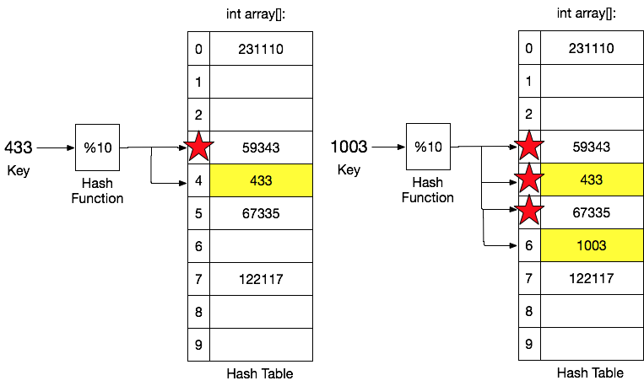
Linear probing to avoid collisions
If the default entry is occupied, go to the next empty index and use it instead

Slide 24
IntegerSetHT::insert
bool IntegerSetHT::insert(int data)
{
int index = hash(data);
int bucketsProbed=0;
while (bucketsProbed++ < 10) { // try 10 times (better if configurable)
if (table[index] < 0) {
table[index] = data;
return true;
}
index = (index+1)%size; // (% size) lets us wrap around to first index
}
return false;
}

Slide 25
Linear probing for search and remove
Search and remove also need to change so that we can find data not in its default location
Does linear probing eliminate the O(1) behavior we want?
More about this next time.

Slide 26
Summary
The set data type allows us to hold data in either ordered or un-ordered form, and typically supports a find/search operation.
Making find efficient is often very important.
A hash table is a data structure that makes inserting and search for data fast: O(1)
Components: hash table array, data, key, hash function
A hash table is commonly thought of as a set with insertion, find, and remove operations
We must be careful to deal with collisions; linear probing looks for next available free index

Slide 27
References
1. ZyBook on Data Structures, chapter 15.1-3.3

Slide 28
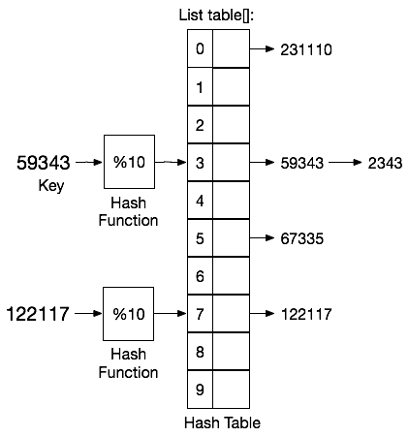
Chaining
Chain all of the data in the same bucket together in a linked list.
The table is now an array of linked lists.

Slide 29
IntegerSetCHT derived class
class IntegerSetCHT : public IntegerSet {
int size; // size of the table
List *table; // pointer to the table
int hash(int);
public:
IntegerSetCHT(int htsize=1000);
// override ABC
void insert(int) override; //override keyword asks compiler to do extra checks
bool search(int) override;
void remove(int) override;
};

